Slide 1
Monte Carlo BlackJack
IN2-2018 Nikola Matijevic
IN3-2018 Marko Todorcevic

Slide 2
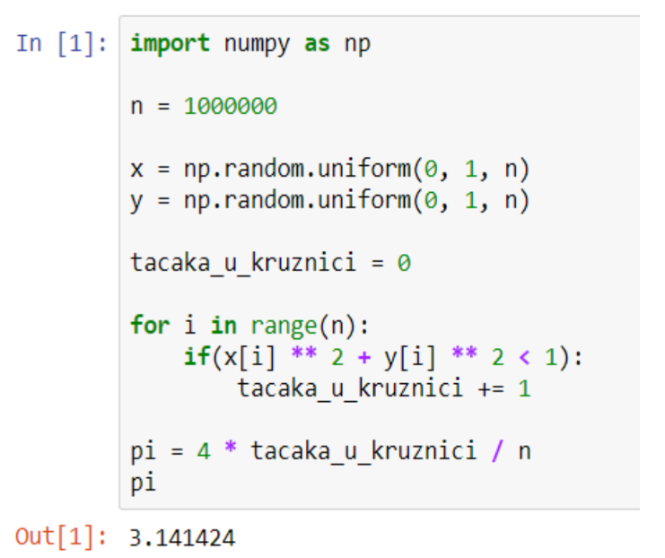

Slide 3
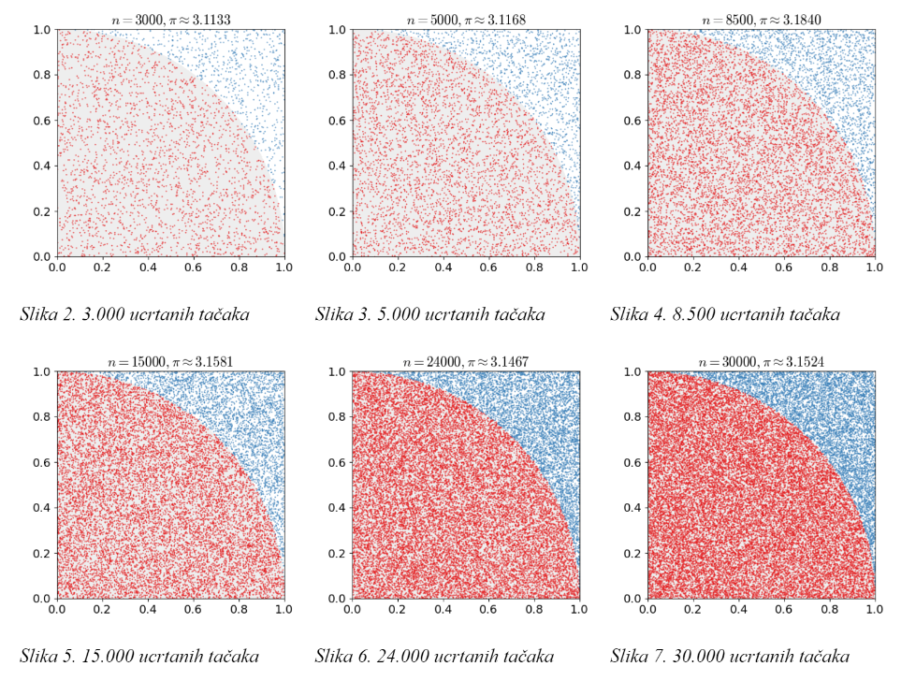

Slide 4


Slide 5
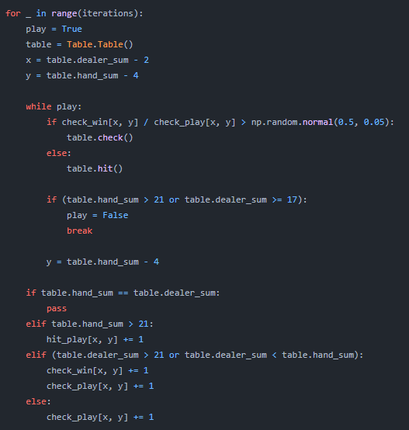

Slide 6
